Slide 1


SOCIAL BUZZ ANALYSIS: Exploring Top Content Categories Driving User Engagement

Slide 2


Today's agenda
Project recap
Problem
The Analytics team
Process
Insights
Summary

Slide 3


Social Buzz, founded in 2010, has rapidly ascended as a leading force in social media and content creation, experiencing exponential growth. With over 500 million monthly users, their rapid growth poses data management challenges.
Accenture has begun three months POC on these tasks:
An audit of their big data practice
Recommendations for a successful IPO
An analysis of their content categories that
highlights the top 5 categories with the largest aggregate popularity.
Project Recap

Slide 4


Problem
1,00,000 posts per day
3,65,00,000 pieces of content per year
Over 500 million active users monthly
How can Social Buzz leverage its extensive user engagement and abundant content for maximum profitability?
Analysis to find the top 5 categories of content of social buzz.

Slide 5



Andres Fleming
(Chief Technical Architect)
The Analytics team
Marcus Rompton
(Senior Principle)
Gagana
(Data Analyst)

Slide 6

Process
1
Data understanding
2
Data Cleaning
3
Data Modelling
4
Data Analysis
5
Identifying Insights

Slide 7
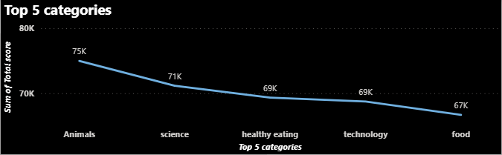


Insights
Out of all the 16 categories the top 5 categories of content are:
1.Animals (74965)
2.Science(71168)
3.Healthy Eating(69339)
4.Technology(68738)
5.Food(66676)

Slide 8
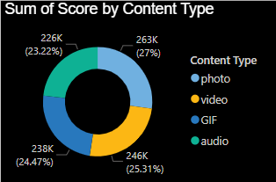
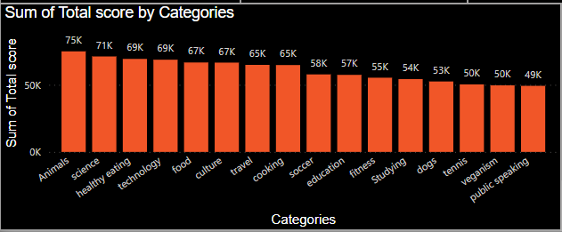
Photo had the highest sum of score at 262838 followed by videos, GIF and audio.
There are a total of 16 unique categories

Slide 9
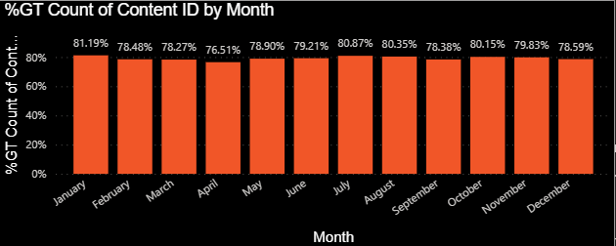
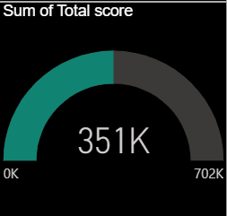
-There are 1897 reactions to the most popular category.
-The month with highest posts is January
-The sum to all the categories scores is 351K

Slide 10
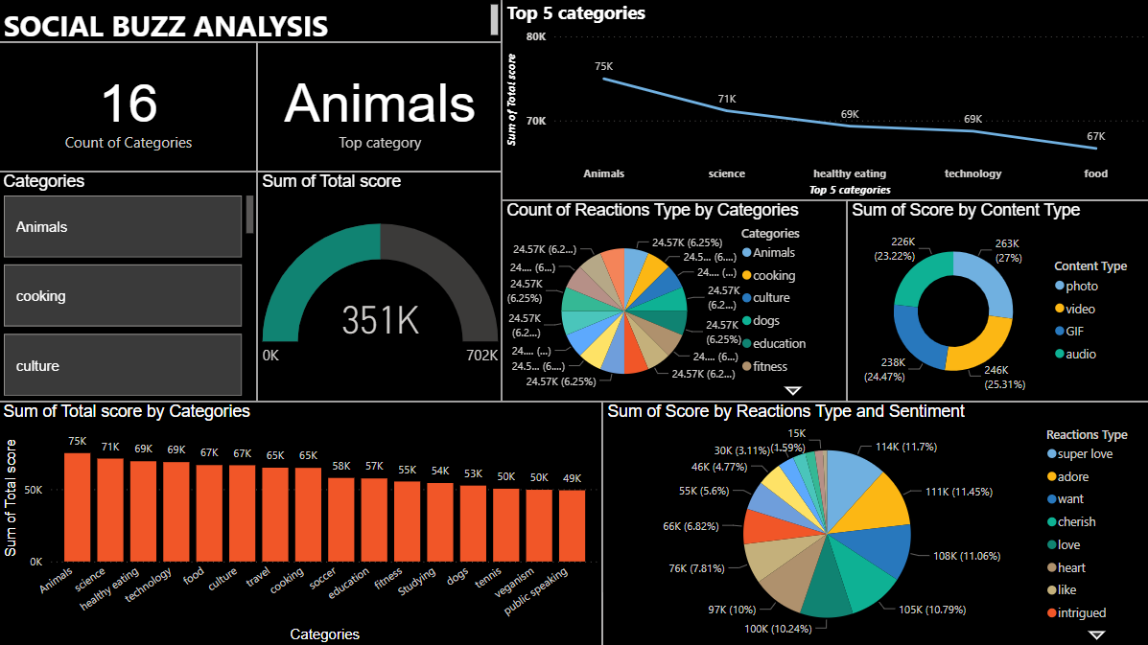

Slide 11


ANALYSIS
Animals and science are the two most popular categories of content, showing that people enjoy "real-life" and "factual" content the most.
INSIGHT
Food is a common theme with the top 5 categories with "Healthy Eating" ranking the highest. This may give an indication to the audience within your user base. You could use this insight to create a campaign and work with healthy eating brands to boost user engagement.
Summary
NEXT STEPS
This ad-hoc analysis is insightful, but it's time to take this analysis into large scale production for real-time understanding of your business. We can show you how to do this.

Slide 12

Thank you!
ANY QUESTIONS?

